Slide 1

AI Infrastructure Opportunities in India
POWERING THE SMART WORLD

Slide 2
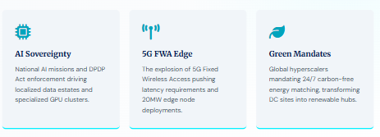
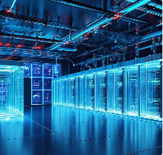
Al Infrastructure: Key Strategic Pillars
Gigawatt Scaling: Moving beyond MW-scale colocation to massive self-build Al compute hubs.
Thermal Mastery: Transitioning from legacy air cooling to 4OkW+ liquid immersion and D2C systems.
Silicon-First Power: Specialized PSUs designed for Blackwell (B200) and Neoverse (ARM) densities.
Energy Sovereignty: Captive 24/7 renewable loops + Energy Storage Systems (ESS) integrated at source.

Slide 3
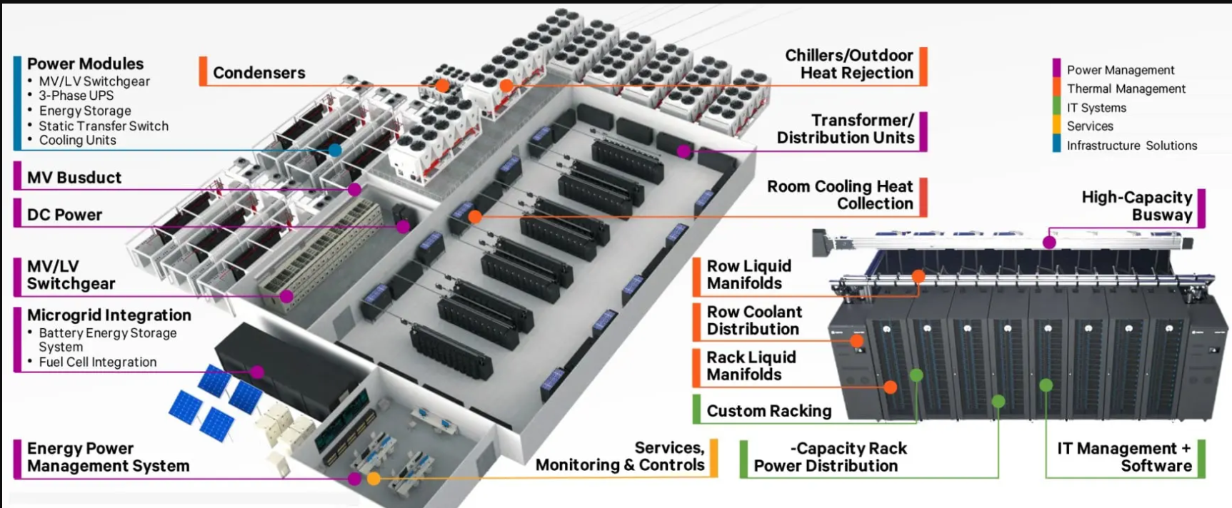
AI Infra | Products & Layout

Slide 4
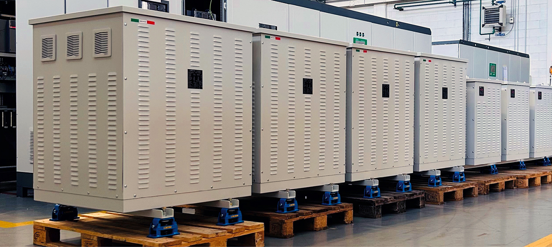
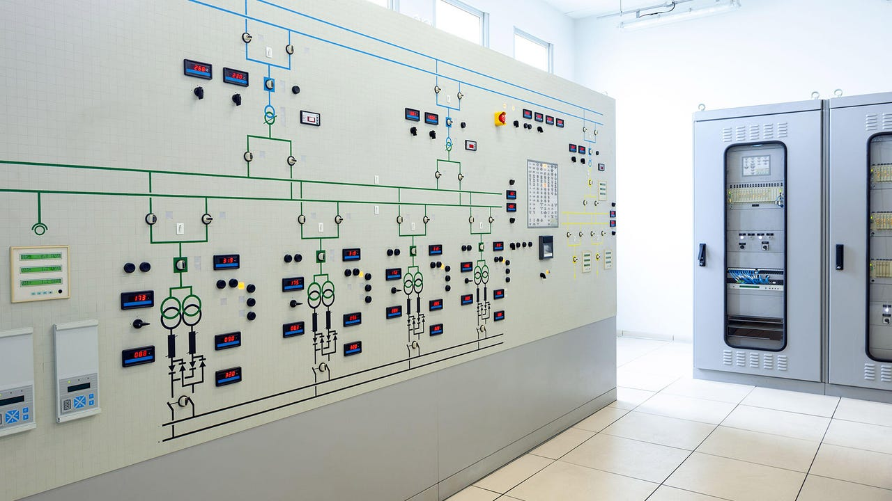
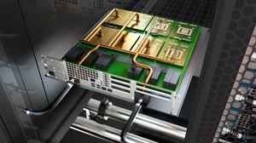
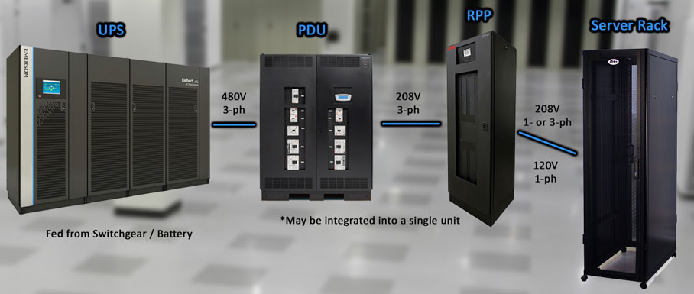
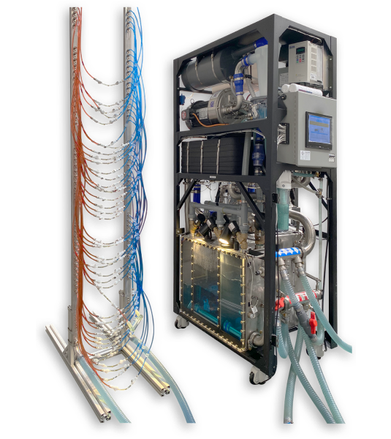
AI Infra | Potential Products portfolio
High efficiency isolation transformer systems
Switch board/Switch gear systems
Thermal Solutions
Power distribution System
Cooling system

Slide 5
South India Data Center & Tech Investment Tracker
Company Name | Core Investment Focus & Regional Footprint | Target Pipeline Capacity | Latest Investment Commitment / Scale
L&T Vyoma & L&T Tech | Tamil Nadu (Kanchipuram, Coimbatore, Tiruvallur) • Data Infrastructure: Massive ₹15,000 Cr hyperscale expansion in Kanchipuram with liquid-cooled, 80kW/rack AI architectures. • Hardware Supply Chain: ₹2,500 Cr advanced electronics manufacturing unit in Coimbatore. • Green Energy Integration: ₹1,100 Cr Kattupalli Shipyard expansion for offshore wind fabrication. | 250 MW – 370 MW+ (National pipeline total) | ₹18,600 Crore (Total consolidated state MoU)
Yotta Data Services | (Navi Mumbai, Greater Noida, Gift City) • Actively deploying thousands of NVIDIA H100/B200 clusters via the dedicated Shakti Cloud platform for deep learning workloads. | 350 MW | NVIDIA Strategic Partnership Ecosystem
Digital Connexion | Tamil Nadu (Chennai - Ambattur Corridor) • High-profile JV between Brookfield, Reliance Industries, and Digital Realty. Fully operationalized its premier 100 MW MAA10 campus. | 250 MW | Institutional Asset Backing
Iron Mountain Data Centers (Web Werks) | Tamil Nadu & Maharashtra (Chennai, Mumbai, Pune) • Transitioning from localized colocation into high-capacity hyperscale hubs via a massive capital infusion strategy. | 152 MW – 200 MW | ₹7,500 Crore (Consolidated expansion funnel)
Sify Infinit Spaces | Andhra Pradesh & Tier-2 South (Vizag, Bhopal, Lucknow) • Creating localized AI-Hubs and an alternative eastern subsea landing gateway via a new 50 MW critical IT load facility in Visakhapatnam. | 200 MW+ | Distributed Corporate Capital Injection
Princeton Digital Group (PDG) | Maharashtra & Tamil Nadu (Navi Mumbai, Chennai Expansion) • Scaling up high-density hyper-dense rack spacing to host multi-tenant cloud architectures for global internet giants. | 100 MW – 150 MW | Pan-Asian Institutional Funding

Slide 6
AI Infra | Global Players
Category | Company Name | Headquarters | Primary Operating Model | Presence in India | AI / High-Density Focus (Rack Cooling Limit)
Hyperscaler | Amazon Web Services (AWS) | United States | Cloud & AI platform service provider | Massive / Self-Build Owner (Moving away from 3rd-party tenancy) | Very High (Liquid-assist & direct-to-chip models)
Hyperscaler | Microsoft Azure | United States | Cloud & AI platform service provider | Massive / Self-Build Owner (Hyderabad region live mid-2026) | Very High (Air-cooled chillers with zero water consumption)
Hyperscaler | Google Cloud Platform | United States | Cloud & AI platform service provider | Hybrid Expansion (Owns 1 GW AP site + Adani JV) | Very High (Dedicated Vertex AI tensor clusters)
Hyperscaler | Meta Platforms | United States | Social & AI compute cluster builder | First Dedicated Site Live (Leasing 168 MW custom node from Reliance) | Very High (Desalinated seawater cooling for custom Llama LLM workloads)
Hyperscaler | Oracle Cloud (OCI) | United States | Enterprise Database & Cloud Infrastructure | Expanding Baseline (Dedicated sovereign region nodes) | High (High-density database clustering)
Hyperscaler | Alibaba / Tencent Cloud | China | Cloud platform service provider | Frozen / Exit | None (Geopolitical restrictions)
Colocation Operator | AirTrunk (Blackstone) | Australia / US | Wholesale Hyperscale Developer | Aggressive Entrant (Acquired Lumina; targeting 5 GW footprint) | Extremely High (Custom megawatt modular blocks for external AI leases)
Colocation Operator | Equinix | United States | Carrier-Neutral Interconnection Provider | High-Density Mesh (Active MB3 in Mumbai & CN1 in Chennai) | High (Interconnected multi-cloud AI private network nodes)
Colocation Operator | Digital Realty (BAM Digital) | United States | Wholesaler & Real Estate Investment Trust | Active Mega-Scale (100MW MAA10 Ambattur, Chennai campus live) | High (IGBC Platinum certified high-thermal chassis architecture)
Colocation Operator | CyrusOne / GDS Holdings | US / China | International wholesale colocation | No Direct Operations | Low (Focus shifted entirely to other APAC/EMEA regions)

Slide 7
India – Domestic Operator | ST Telemedia Global Data Centres (STT GDC) | India / Singapore | Pure-play carrier-neutral colocation | Market Co-Leader (Expanding footprint + Kolkata expansion) | High (Active multi-million dollar retrofit for direct-to-chip cooling)
India – Domestic Operator | NTT Global Data Centers | Japan / India | Managed IT & Wholesale colocation | Market Co-Leader (Active 400 MW AI partnership with Neysa) | High (Enterprise liquid-cooling clusters)
India – Domestic Operator | CtrlS Datacenters | India | Enterprise & Tier-4 premium operator | Strong Defensive Expansion (612 MW flagship facility in Hyderabad) | High (40 kW to 80 kW high-density racks with immersion loops)
India – Domestic Operator | AdaniConEx | India | Greenfield Infrastructure & Energy JV | Massive Scaling Threat (Building up a multi-decade $100B footprint) | High (100% backward-integrated green captive energy loops)
India – Domestic Operator | Reliance Industries (Jio) | India | Telecom-integrated platform owner | Mega Infrastructure Engine (Building the Jamnagar and Vizag nodes) | Very High (Host to Meta’s primary Indian AI data core)
India – Domestic Operator | Yotta Data Services | India | High-Performance Sovereign Cloud | Specialized AI Cloud Provider (Preparing a $900M domestic IPO) | Extremely High (One of the largest sovereign distributors of NVIDIA GPU setups)
India – Domestic Operator | Nxtra Data (Bharti Airtel) | India | Telecom-linked data infrastructure | Edge-Network Leader (Active Tier-2/Tier-3 city edge node rollout) | Medium (Focused on 5G FWA and ultra-low latency data routing)
India – Domestic Operator | RackBank Datacenters | India | Custom Green AI Infrastructure | Active Niche Disruptor (Building the AI Data Centre Park in Raipur) | Extremely High (Patented liquid immersion tech for 80kW+ server setups)

Slide 8
Market Opportunity
Segment | Current Market Value (USD) | Projected 2034 Market Value (USD) | Adjusted CAGR (2026–2034) | Current Import Dependency | Dominant India-based Manufacturers / JVs | Major Global Players (Import/Direct) | Current Market Trends & Structural Disruptions
Data Centers (Servers & AI Compute) | $10.5–11.2 Bn | $41.5–43.0 Bn | 25.5% (Driven by Gen-AI spike) | ~45–50% (Dropped significantly due to local assembly) | Netweb Technologies (Tyrone ARM & liquid servers), VVDN Technologies (JVs with HPE), Kaynes Technology | NVIDIA, Dell Technologies, Supermicro, Hewlett Packard Enterprise (HPE), Lenovo | The Local AI-Server Supercycle: Hyperscalers are buying specialized GPU clusters. Massive shift from standard x86 architectures to custom high-core ARM nodes assembled locally under PLI schemes.
Networking (Switches/Routers/Fiber) | $1.85–2.10 Bn | $6.2–6.8 Bn | 16.5% | ~55% | Tejas Networks (Tata Group), HFCL, Wistron India (expanding network manufacturing) | Cisco Systems, Arista Networks, Juniper Networks, Huawei | Ultra-Low Latency & 5G FWA: High-speed interconnect architectures (Infiniband and 800G Ethernet switches) are surging to process distributed LLM token pipelines without data-routing bottlenecks.
Power Infrastructure (UPS, PDU, Clean Energy) | $1.60–1.85 Bn | $5.8–6.4 Bn | 18.2% | ~35% | Schneider Electric India (expanded local plants), Delta Electronics India, Kirloskar Oil Engines | Vertiv, ABB, Eaton Corporation, Caterpillar | Sovereign Microgrids & ESG Mandates: Shift toward mega-scale modular busways and green intelligent PDUs. Driven by India's Green Open Access policy, facilities are connecting directly to captive solar/wind grids.
Cooling Solutions (Liquid, Direct-to-Chip, HVAC) | $1.20–1.45 Bn | $7.5–8.2 Bn | 28.4% (Highest growing segment) | ~40% | Blue Star, Voltas, Schneider India, Vertiv India (local thermal manufacturing) | STULZ, Rittal, Vertiv Global, Danfoss, Boyd Corporation | The Death of Traditional Air Cooling: Because AI chips generate intense thermal footprints, standard CRAC systems have been replaced. Massive capex is pouring into Direct-to-Chip (D2C) cold plates and rear-door heat exchangers.
Notes:
The Localization Triumph: Import dependency across servers and compute has plummeted from nearly 80% down to 45–50%. Major supply chains have shifted to local electronics manufacturing services (EMS) providers based in tech hubs like Chennai and Bengaluru.
Cooling is the Ultimate Bottleneck: Advanced liquid cooling has flipped from an experimental addition to the fastest-growing sub-sector in the entire ecosystem ($1.2B to over $7.5B by 2034), with a staggering 28.4% CAGR outperforming raw compute growth.
The Power Grid Crunch: Power infrastructure demands have moved toward intelligent, solid-state green energy modules as facilities scale past the 100 MW per campus mark, requiring heavy multi-megawatt backup topologies.

Slide 9
Market Opportunity
Global Rank | Company | Origin | Core Segment Category | Est. India 2034 TAM (USD) | Est. India Market Share | Segment CAGR (2026–2034) | Current Strategic Focus | Salcomp Strategic Opportunity (Local EMS & Component Play)
1 | Dell Technologies | Global (USA) | Servers, Storage, Core Enterprise & Edge AI | Servers: $22B–$24B Storage: $7B | High (~26–28%) | 22.5% | Assembling AI-first mainstream server blocks locally via domestic manufacturing partners to meet strict public sector localization policies. | Box-Build Optimization: Mass PCBA assembly, sheet-metal server rack enclosures, and localization of high-wattage desktop and rack power adapters.
2 | Hewlett Packard Enterprise (HPE) | Global (USA) | Hyperscale Cloud, Storage & High-Performance Compute | Servers: $22B–$24B Storage: $7B | High (~22–25%) | 21.8% | Executing massive domestic production through its active manufacturing JV with VVDN Technologies in Chennai. | Thermal Subsystems & SMT Lines: Local SMT (Surface Mount Technology) assembly for server control boards, structural server chassis panels, and thermal chassis mounts.
3 | Inspur Group | Global (China) | Hyperscale Clouds & ODM (Original Design Manufacturer) Server Blocks | Restricted | Very Low (<3%) | Flat / Dropping | Geopolitical constraints have severely choked standard imports into Indian public data cores. Shifting strictly to minor private cloud leases. | Minimal Opportunity: Restricted expansion limits localized volume pipeline potential due to high regulatory risk.
4 | Lenovo | Global (China) | Cost-Competitive Enterprise & Edge AI Servers | Servers: $22B–$24B | Moderate (~14–16%) | 18.2% | Utilizing local assembly hubs to scale up cost-effective liquid-cooled rack options tailored for regional Tier-2/3 cloud providers. | High-Volume SMT Component Sourcing: Opportunity to handle plastic injection housings, local system integration (FATP), and power line cords.
5 | Supermicro | Global (USA) | High-Density, GPU-Optimized Custom AI Server Blocks | Servers: $22B–$24B | Rapidly Rising (~15–18%) | 29.4% | Supplying raw, ultra-dense GPU architectures to major Indian operators (like Yotta and CtrlS) for heavy LLM training models. | High-Density Racks & Custom Busbars: Building heavy metal structural server cages, complex internal structural cable integration, and high-efficiency power distribution assemblies.

Slide 10
6 | IBM | Global (USA) | Legacy Enterprise Mainframes, Hybrid Cloud & Secure Storage | Servers: $18B–$20B Storage: $7B | Low–Mid (~6–8%) | 11.5% | Migrating banking, financial services (BFSI), and enterprise mainframes into localized, ultra-secure hybrid cloud setups. | Selective High-Precision Integration: Manufacturing high-reliability multilayer PCBs, advanced copper-core wiring paths, and secure metal enclosures.
7 | Cisco Systems | Global (USA) | Enterprise Networking, Intelligent AI Fabrics & Core Switches | Networking (TAM): $6.2B–$6.8B | High (~32–35%) | 16.5% | Moving production directly to India to build advanced 800G high-speed Ethernet fabrics to link massive GPU blocks without latency drops. | Redundant Power Supplies (CRPS): Supplying Salcomp's specialized CRPS Series (800W to 4000W) front-end power modules. Manufacturing mechanical subassemblies and shielding.
8 | Arista Networks | Global (USA) | Hyperscale Data Center Switching & Software Networks | Networking (TAM): $6.2B–$6.8B | Moderate (~18–20%) | 20.5% | Capturing cloud-native spaces by deploying advanced AI spine-and-leaf network layouts for direct hyper-scaler estates. | Network Enclosures & High-Precision EMS: Local structural casing assembly, complex connector overmolding, and intermediate power board layouts.
9 | NetApp | Global (USA) | High-Performance AI Data Management & Flash Storage | Storage (TAM): $7.5B–$8.2B | Moderate (~22–24%) | 15.0% | Standardizing massive all-flash arrays explicitly configured to feed data continuously into multi-gigawatt AI training farms. | Storage Chassis Assembly: Heavy mass-manufacturing of drive trays, cold-rolled steel storage arrays, internal power links, and fan tray assemblies.
10 | Huawei | Global (China) | Telecom Infrastructure, Storage & Cloud Networks | Restricted | Negligible (<1%) | None | Effectively locked out of the core national data grid due to geopolitical mandates, focusing strictly on small legacy enterprise maintenance. | Zero Target Opportunity: Heavy compliance blocks prevent local contract expansions.

Slide 11
Global Market Opportunity
Global Rank | Company | Origin | Segment Category | India 2026 Opportunity (USD) | Adjusted Segment CAGR ('26–'30) | Current Global Market Share | Salcomp Opportunity Rating | Updated Specific Target Opportunity for Salcomp
1 | NVIDIA | USA | AI Compute (GPU, Tensers, Accel) | $4.8–5.2 Bn | 35%+ | ~85–90% (AI GPUs) | Low (Direct) | Custom sheet-metal GPU tray enclosures, structural structural busbars, and precision mechanical stiffeners.
2 | Dell Technologies | USA | AI Servers & Enterprise Storage Systems | $3.2–3.6 Bn | 18% | ~18–20% (Servers) | Medium | Turnkey server rack frame integration, CRPS box-builds, and high-amperage internal wiring harnesses.
3 | HPE | USA | AI Servers, Edge Nodes & AI Fabrics | $2.6–3.0 Bn | 18% | ~15% (Servers) | Medium–High | Localizing complete SMT board assembly, structural mechanical bracing, and sub-chassis frame panels.
4 | Supermicro | USA | GPU-Dense Application Optimized Servers | $2.4–2.8 Bn | 30% | ~14–16% (AI Servers) | High | Heavy system box-builds, complex multi-tier internal cable routing, and dense modular power shelf assemblies.
5 | Lenovo | China | Cost-Effective Cloud & Enterprise Compute | $1.6–1.9 Bn | 16% | ~12–14% (Servers) | Medium | Automated high-volume component placement, plastic structural moldings, and backplane connect overmolding.
6 | Vertiv | USA | Liquid Cooling Loops & Smart Power Infra | $2.2–2.5 Bn | 26% | ~25–28% (DC Power/Cooling) | Very High | High-density Intelligent Power Distribution Units (iPDUs), power shelving, and cold-plate copper tubing assemblies.
7 | Schneider Electric | France | High-Capacity Grid Influx & Industrial Cooling | $2.4–2.7 Bn | 24% | ~22% (DC Infra) | Very High | Advanced power electronics subassemblies, complex structural control cabinets, and busway lines.
8 | Eaton | Ireland / USA | Modular UPS Systems & Power Solutions | $1.5–1.8 Bn | 20% | ~12–14% (UPS Power) | High | Precision Common Redundant Power Supply (CRPS) subassembly, magnetic component winding, and localized casing stamping.
9 | STULZ | Germany | Advanced CRAC & Close-Coupled Liquid Cooling | $1.4–1.7 Bn | 28% | ~16% (DC Thermal) | High | Assembly of Rear-Door Heat Exchangers (RDHx), fluid distribution manifolds, and custom pump chassis mounts.
10 | Cisco | USA | 800G Ethernet Switches & Low-Latency AI Fabrics | $1.6–1.9 Bn | 15% | ~38% (DC Networking) | Medium | Manufacturing complex network interface card (NIC) housings, localized high-efficiency internal power modules, and sheet-metal switch casings.
Notes:
The Thermal & Power Surge: Notice how the CAGR for companies like Vertiv, Schneider Electric, and STULZ has surged way past the older estimates (now tracking at 24–28%). This is because high-density AI clusters generate extreme heat footprints that legacy air-conditioning units literally cannot cool, causing a massive, urgent cash injection into liquid infrastructure components.
Refined EMS Target Points: For an expert contract assembler, the primary value add is no longer just standard plastic housings. The margins have moved squarely to building high-density, hot-swappable CRPS units (up to 4000W), precision fluid manifolds for liquid distribution loops, and solid-state power shelf enclosures that hold dense GPU computing arrays securely.

Slide 12
India Data Center Market: Upcoming Mega-Investments & Projections
Projected Rank (By 2034) | Upcoming / Investing Company | Projected 2030–2034 Capacity (GW) | Projected Market Share (By 2034 Pipeline CapEx) | Latest Investment Commitment ($M / ₹ Crore) | Primary Strategic Focus & AI Tech Shift
1 | AirTrunk (Global Hyperscale Entrant) | 5.0 GW | 22% to 25% | $36,000 M (₹3,00,000 Crore) | Massive hyper-scale AI infrastructure corridors across major metro regions.
2 | AdaniConex (Adani + EdgeConex JV) | 2.5 to 3.0 GW | 18% to 20% | $23,333 M (Part of $16.7B Google Tie-up) | High-density GPU clustering, massive greenfield sites with backward-integrated captive renewable energy.
3 | Reliance Industries | 3.0 GW | 15% to 17% | $22,222 M (₹1.8 Lakh Crore) | Gigawatt-scale mega campuses in Jamnagar & Visakhapatnam integrated with local 5G FWA edge deployment.
4 | Amazon Web Services (AWS) | 1.5 to 2.0 GW | 10% to 12% | $12,700 M | Sovereign public cloud expansion and dedicated regional cloud nodes (massive footprint in Hyderabad).
5 | Microsoft India | 1.2 to 1.5 GW | 11% to 13% | $17,500 M | AI-exclusive self-build data estates explicitly designed for high-density Azure AI workloads.
6 | TCS HyperVault | 1.2 GW | 3% to 5% | $6,667 M | Sovereign cloud frameworks for BFSI & Government sectors complying with strict DPDP localization rules.
7 | Google Cloud India | 1.0 GW | 6% to 8% | $6,000 M | Greenfield hyperscale facility in Andhra Pradesh and AI cloud localization.
8 | NTT Data & Neysa Networks | 0.8 to 1.0 GW | 8% to 10% | $1,260 M (₹10,500 Crore MoU) | Co-developed specialized liquid-cooled AI data center clusters in Telangana.
9 | ST Telemedia Global Service (STT GDC) | 0.6 to 0.8 GW | 6% to-8% | $1,500 M | Direct-to-chip liquid cooling deployments, expanding into Eastern India (Kolkata Campus).
10 | CtrlS Datacenters | 0.5 to 0.8 GW | 5% to 7% | $1,200 M | 40 kW high-density racks using advanced immersion cooling to host NVIDIA H100/B200 clusters.
Notes:
Green- already invested and certain companies are about to deploy(Microsoft India)
Brown- new and upcoming investors

Slide 13
Global Supply Chain
SNo | Upcoming / Investing Company | Core Subsystems | Primary Layer 2 OEMs | Layer 1 Sub-Component Suppliers | Downstream Assemblers / Integrators
1 | AirTrunk (Blackstone Portfolio) | Heavy Power Substation Liquid Chillers & CRAHs Core Network Fabric | Hitachi Energy / Siemens Vertiv / Stulz Cisco / Arista | Nippon Steel (CRGO Steel) Danfoss (Compressor Blocks) Broadcom (Switching ASICs) | • Lumina CloudInfra (Acquired domestic development & structural assembly division).
2 | AdaniConneX (Adani + EdgeConneX) | On-site Green MV Grid Modular Li-ion UPS Systems Gensets & Cooling Loop | Hitachi Energy / Siemens Vertiv / Schneider Electric Cummins / Caterpillar | Solvay ($SF_6$ Arc Quenching Gas) Samsung SDI / CATL (Cells) Bosch (Engine ECUs / Injectors) | GMMCO / Gainwell (CAT packaging) L&T E&A (Custom MV/LV Switchboards) EdgeOS (Unified Software Integration)
3 | Reliance Industries | 5G-FWA Integrated Grid High-Density Cooling Walls Secure Perimeter | Siemens / ABB India Daikin / Trane Bosch Security / HID Global | JFE Steel (Transformer Sheets) EBM-Papst (EC Motorized Fans) Nvidia (CCTV Edge AI Processing) | Jio Infra Engineering (In-house captive assembly & 5G edge network integration).
4 | Amazon Web Services (AWS) | Sovereign Grid Switching Evaporative Air Systems Nitro Smart Rack Power | Schneider Electric / Eaton Munters / Vertiv Cisco / AWS Custom Hardware | Infineon / Mitsubishi (IGBT Silicon) CAREL (Microcontrollers) Marvell (Fiber Transceivers) | Sterling & Wilson / Megha Engineering (Turnkey electro-mechanical EPC site integration).
5 | Microsoft India | High-Transient UPS Systems Direct-to-Chip Liquid Loops Optical Cross-Connects | Vertiv / Emerson CoolIT Systems / Motivair Juniper Networks / Cisco | LG Energy Solution (UPS Battery Cells) Wieland (High-Purity Copper Plates) Finisar (Laser Optics components) | Jones Lang LaSalle (JLL) / Schneider Systems (Advanced hyperscale modular deployment).

Slide 14
Sno | Upcoming / Investing Company | Core Subsystems | Primary Layer 2 OEMs | Layer 1 Sub-Component Suppliers | Downstream Assemblers / Integrators
6 | TCS HyperVault | BFSI-Spec Isolated UPS Precision CRAH Units Multilayer Vault Access | Eaton / Schneider Electric Stulz India / Vertiv Honeywell (VESDA) / Axis | Fuji Electric (Inverter Switching) iehl-Abegg (Precision Fans) Xtralis (Laser Smoke Sensing Chambers) | • Tata Projects (Captive internal EPC arm executing all structural panel building and facility assembly).
7 | Google Cloud India | Modular High-PUE Power Panels Custom Chilled Water Plants Zero-Trust Software Network | Schneider Electric / ABB Trane / Daikin Cisco / Google Custom Silicon | Hindalco (99.99% Pure Copper Busbars) Bitzer (Centrifugal Compressors) Intel / AMD (Monitoring Nodes) | L&T Construction / Honeywell Building Solutions (Advanced automation integration).
8 | NTT Data & Neysa Networks | Liquid-Cooled AI Power Blocks Rear-Door Heat Exchangers Ultra-Low Latency Fabric | Vertiv / Fuji Electric Stulz / CoolIT Systems Arista Networks | Samsung SDI (High-density Li-ion) Danfoss / Copeland (Compressor parts) Broadcom (Network ASICs) | NTT Global Facilities Division paired with Neysa AI Orchestration software layers.
9 | ST Telemedia GDC (STT GDC) | • High-Density 120kW Racks • In-Row & RDHx Liquid Loops • Patented AI IMBS Monitoring | • Schneider Electric / Vertiv • Vertiv / Stulz / Motivair • Honeywell / Siemens Building | • Infineon Technologies (Power Semiconductors) • EBM-Papst (EC Fans) • Siemens (Programmable Logic Boards) | • STT GDC Pune Innovation Lab (Internal design validation) + regional electrical panel integrators.
10 | CtrlS Datacenters | • 40 kW Dual-Fed UPS Paths • Liquid Immersion Coolers • Advanced Fire Suppression | • Schneider Electric / ABB India • Green Revolution Cooling (GRC) • Fike / Kidde Gas Systems | • Mitsubishi Electric (IGBT Power Modules) • Engineered Dielectric Fluids (3M/Shell) • Specialty Gas Release Valves | • CtrlS Engineering Division (Direct modular container assembly and custom cooling tank fabrications).

Slide 15
AI Infra | Core manufacturers vs what they make ( India focus )
Core Infrastructure Manufacturer | What They Manufacture for AI Infrastructure | Global / India Market Trend | Matching High-Growth Product Area in Local Manufacturing Portfolio
Vertiv | Hyperscale power architectures, dense busways, Coolant Distribution Units (CDUs), and localized manifold blocks. | Explosive Expansion: Operating massive factories in India; aggressively scaling production of liquid-cooling loops to meet multi-gigawatt pipelines. | CCU (Close Control Unit) engineering, high-efficiency cold-plate assemblies, and modular integrated rack-cooling chassis.
Eaton | High-density rack PDUs, busway connectors, heavy-duty power modules, and intelligent hot-swappable power inputs. | High Growth: Scaling local production facilities to supply critical power blocks to Tier-4 banking and corporate clouds. | Intelligent PDU output sockets, heavy-gauge copper input connector sets, and solid-state power switches.
Inficon (India EMS / Specialized EMS) | Complex PCB assembly (PCBA), embedded controller architectures, system monitoring firmware, and structural signal diagnostics. | Steady Technical Rise: Increasing complexity of internal controller logic to track real-time liquid flow, pressure, and thermal loads. | High-reliability Intelligent PDU controllers, multi-layer CCU control boards, and micro-controller assembly lines.
Flex / Major Global EMS | Full turnkey box-builds, mechatronics integration, power shelves, and complex fluid-handling chassis builds. | Consolidating Power: Acting as the primary outsourced assembly backbone for massive global infrastructure brands on Indian soil. | Turnkey backup electronics assembly for PDUs/CCUs; high-tolerance structural liquid-cooling sub-chassis frames.
Grundfos | High-reliability fluid circulation pumps and dedicated pump-motor blocks designed for continuous data-center cooling loops. | Critical Demand: Shifting from standard HVAC infrastructure to manufacturing precision variable-speed pumps for localized liquid-cooling manifolds. | High-pressure, leak-free CCU coolant circulation pump components and variable-frequency drive (VFD) enclosures.
Modine / Boyd Corporation | Liquid-to-Air/Liquid-to-Liquid plate-frame and tube-fin heat exchangers, micro-channel cold plates, and vapor chambers. | High Density Supercycle: Traditional heat sinks are obsolete. Demand for micro-machined copper cold plates and rear-door heat exchangers (RDHx) has surged. | Cold plate core machining, complex vapor chamber stamping, and multi-tier radiator structural frames.
Submer | Modular liquid immersion cooling tanks and proprietary eco-friendly dielectric fluids for heavy multi-megawatt AI farms. | Niche to Mainstream: Shifting from experimental pilots to active deployments in dedicated "AI Factories" (such as RackBank's Raipur campus). | Heavy-gauge steel Phase-3 liquid immersion tanks, custom fluid sealing gaskets, and busbar isolation panels.
Honeywell / ABB | Industrial-grade IoT smart sensors, flow meters, differential pressure gauges, and automated digital controls. | Hyper-Automation: AI facilities require strict, millisecond-level telemetry monitoring to instantly detect micro-leaks or localized thermal spikes. | High-precision digital temperature, pressure, and fluid-flow sensor sub-assemblies integrated into PDUs and tanks.
Parker Hannifin / Danfoss | High-performance fluid-handling components: ultra-reliable braided hoses, quick-disconnect (QD) couplings, and control valves. | Zero-Tolerance Quality Play: Quick-disconnect couplings must be completely drip-free to prevent fluid from destroying adjacent high-value GPU silicon. | High-precision CNC-machined CCU hydraulic loop fittings, quick-disconnect internal valves, and distribution manifold joints.

Slide 16
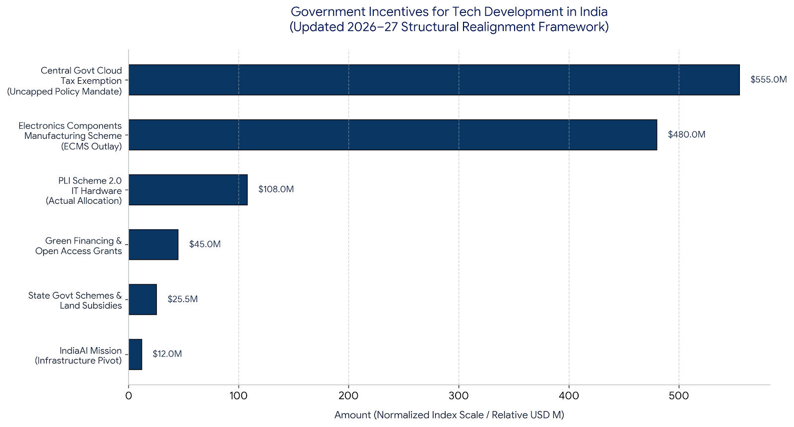

Slide 17
AI Infra | India Summits & Exhibition (2026)
Event Name | Exact / Projected Timeline | Location & Host Venue | Primary Strategic Focus & Tech Shift | Weblinks
3rd Annual Data Centre Conclave 2026 (Nexgen) | August 21, 2026 | Holiday Inn, Mumbai | Powering the AI Revolution through Infrastructure: High-performance computing (HPC) environments, high-density server rack architecture, and next-generation green tech. | nexgenconferences.com
AI Data Centre Conference 2026 | Late October 2026 | Courtyard by Marriott, Mumbai | The Megawatt-to-Gigawatt Grid Realignment: Focused explicitly on the engineering mechanics of handling 30 kW to 100 kW per rack server density constraints and scaling liquid cooling components. | nexgenconferences.com
World Datacentre Summit – India 2026 (TraiCon) | December 6, 2026 | Mumbai | Sovereign Clouds & Advanced Liquid Loops: Dedicated to high-performance storage array enclosures, direct-to-chip interfaces, and compliance tracking under the active DPDP Act. | traiconconferences.com
8th CII Datacenter Blueprint Summit 2027 | March 2027 | Jio World Convention Centre, Mumbai | Building Next-Gen Foundations for AI Factories: The flagship industry policy summit focusing on sustainable structural blueprints, modular/scalable architectures, and green microgrid integration. | cii.in
11th ASSOCHAM Smart Datacenters & AI Summit | May 2027 | HICC, Hyderabad | Regional Infrastructure Incentives & Tech Clusters: Showcasing the real-world execution of the ₹40,000 Crore Component Scheme (ECMS) and state-level power/land waivers. | assocham.org
Data Center Asia & Pacific Expo 2027 (Global DCW Portfolio Expansion) | Mid-2027 | Mumbai / Hong Kong Hub | The Pan-Asian Hyperscale Corridor: Data Center World's new dedicated expansion into the Indian market, tracking the massive influx of self-build hyperscale nodes from AWS, Microsoft, and Meta. | datacentreworldasia.com

Slide 18
Thank you

